Slide 1

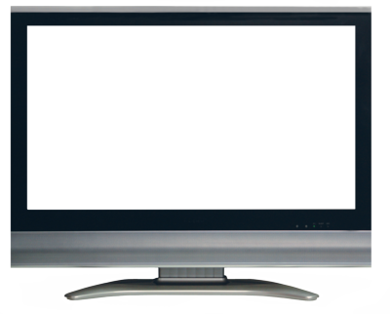
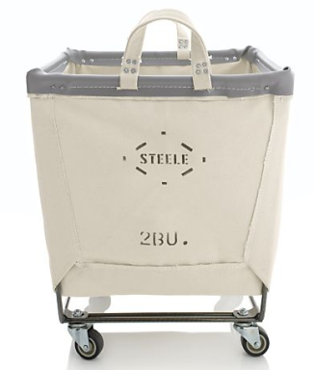


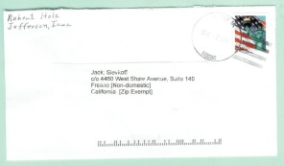
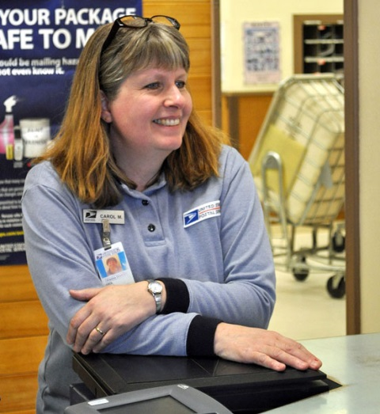
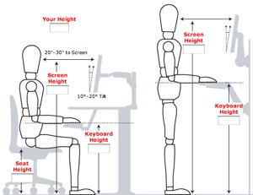
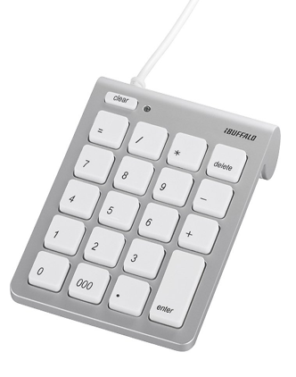
Mail-Sorter Ergonomic Layout
1
Unsorted Mail
Conveyer Belt
Camera
48203
Detroit, MI
Operator loads the mail into hopper
Mail image is displayed on screen, operator visually inspects zip code and keys in zip code into keypad. Mail is routed automatically.
2
3
Operator rotation
keypad
Sit or stand
Customer Service
or Nixie-Bin Sorter
Mail Sorting Station

Slide 2
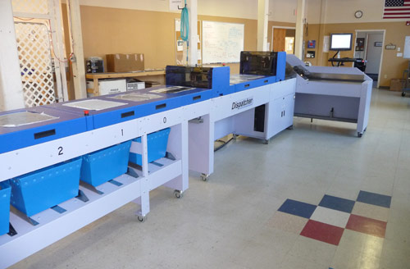
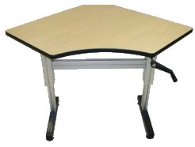



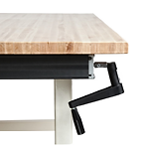
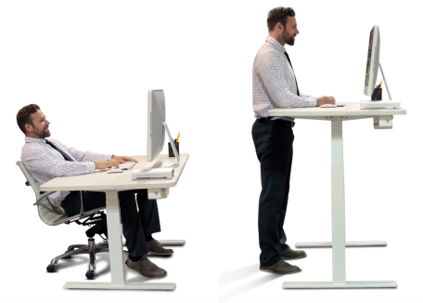
Table Layout
48203
Detroit, MI
Nixie-Bin
Keypad
Confirm

